Slide 1
Siamese/Triplet Networks
Jia-Bin Huang
Virginia Tech
ECE 6554 Advanced Computer Vision

Slide 2
Today’s class
Discussions
Review important concepts of visual recognition
  Instance recognition
  Category recognition
  Supervised pre-training
  Understanding/visualizing
  Segmentation networks
Siamese/Triplet networks for metric learning

Slide 3
Discussion – Think-pair-share
FaceNet: A unified embedding for face recognition and clustering. F. Schroff, D. Kalenichenko, J Philbin, ICCV 2015
Discuss
  strength,
  weakness, and
  potential extension
Share with class

Slide 4
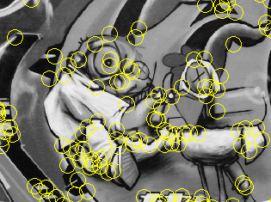
Keypoint detection and descriptors
Keypoint detection: repeatable and distinctive
  Corners, blobs, stable regions
  Harris, DoG
Descriptors: robust and selective
  spatial histograms of orientation
  SIFT

Slide 5

SIFT descriptor
Full version
  Divide the 16x16 window into a 4x4 grid of cells (2x2 case shown below)
  Compute an orientation histogram for each cell
  16 cells * 8 orientations = 128 dimensional descriptor
Adapted from slide by David Lowe

Slide 6
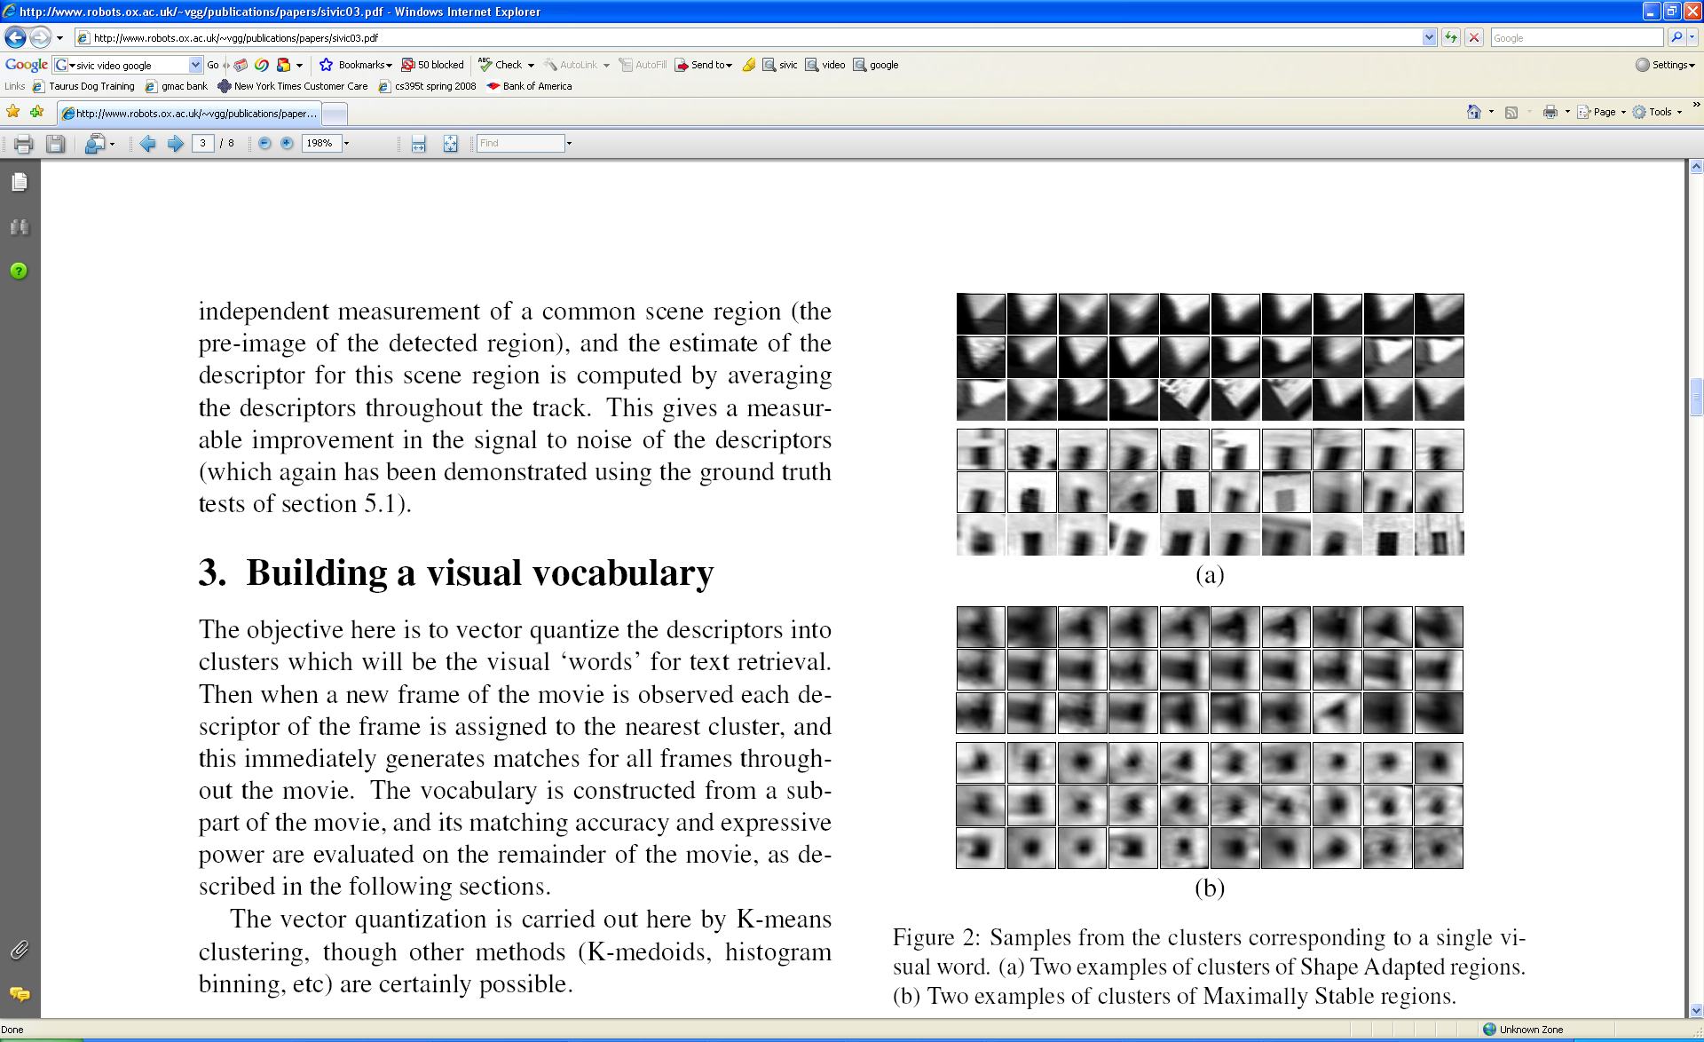
Visual Words
Example: each group of patches belongs to the same visual word
Figure from Sivic & Zisserman, ICCV 2003
Kristen Grauman

Slide 7




Bag of Words Models

Slide 8
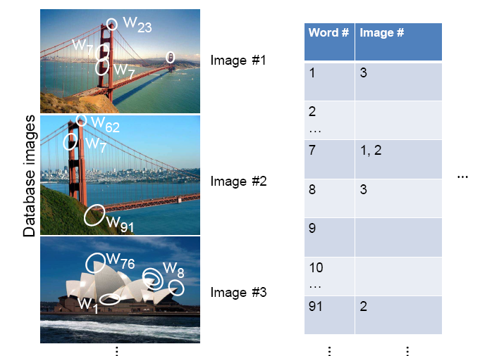
Inverted file index
Database images are loaded into the index mapping words to image numbers
Kristen Grauman

Slide 9
Spatial Verification: two basic strategies
RANSAC
  Typically sort by BoW similarity as initial filter
  Verify by checking support (inliers) for possible transformations
    e.g., “success” if find a transformation with > N inlier correspondences
Generalized Hough Transform
  Let each matched feature cast a vote on location, scale, orientation of the model object
  Verify parameters with enough votes
Kristen Grauman

Slide 10

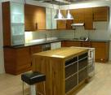
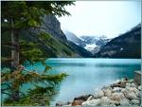


Image Categorization
Training Images
Training
Training Labels
Image Features
Classifier Training
Trained Classifier
Testing
Image Features
Trained Classifier
Prediction
Outdoor
Test Image
Notes:
At testing time, when given a new test image, we extract the same image features and use the trained classified for prediction.

Slide 11
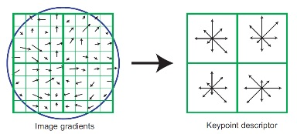
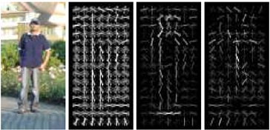
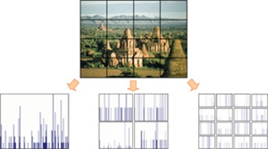
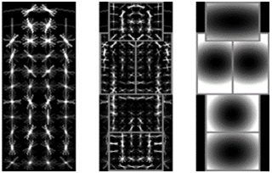
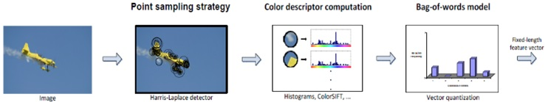
Features are the Keys
SIFT [Loewe IJCV 04]
HOG [Dalal and Triggs CVPR 05]
SPM [Lazebnik et al. CVPR 06]
DPM [Felzenszwalb et al. PAMI 10]
Color Descriptor [Van De Sande et al. PAMI 10]

Slide 12
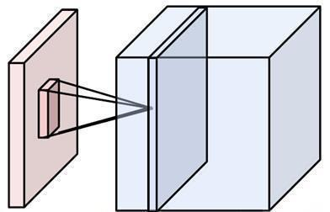
Putting them together
Local connectivity
Weight sharing
Handling multiple input channels
Handling multiple output maps
Weight sharing
Local connectivity
# input channels
# output (activation) maps
Image credit: A. Karpathy

Slide 13
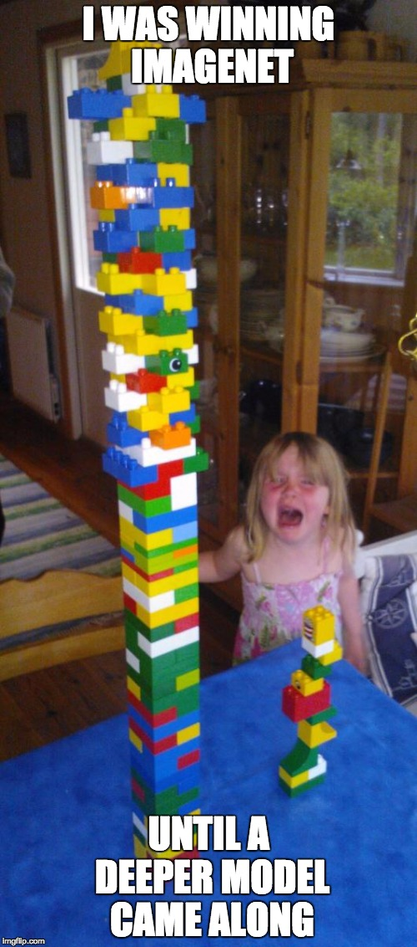
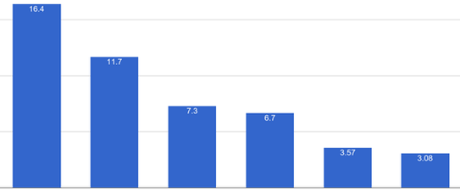
Progress on ImageNet
15
ImageNet Image Classification Top5 Error
10
5
2012
AlexNet
2013
ZF
2014
VGG
2014
GoogLeNet
2015
ResNet
2016
GoogLeNet-v4

Slide 14
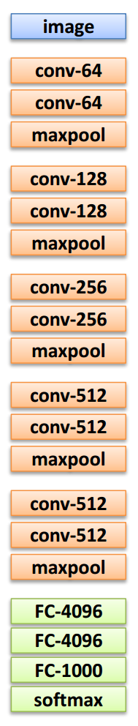
VGG-Net
The deeper, the better
Key design choices:
  3x3 conv. Kernels
  - very small
  conv. stride 1
  - no loss of information
Other details:
  Rectification (ReLU) non-linearity
  5 max-pool layers (x2 reduction)
  no normalization
  3 fully-connected (FC) layers

Slide 15
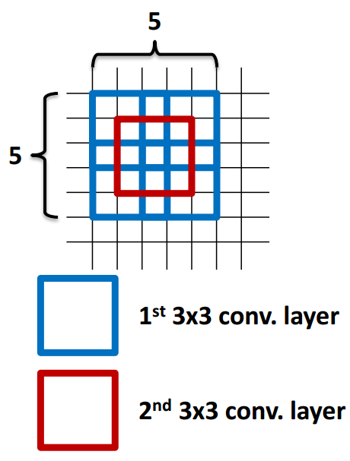
VGG-Net
Why 3x3 layers?
  Stacked conv. layers have a large receptive field
  two 3x3 layers – 5x5 receptive field
  three 3x3 layers – 7x7 receptive field
More non-linearity
  Less parameters to learn
  ~140M per net

Slide 16
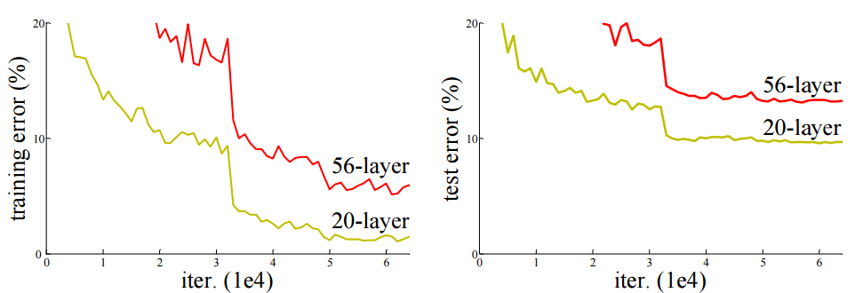
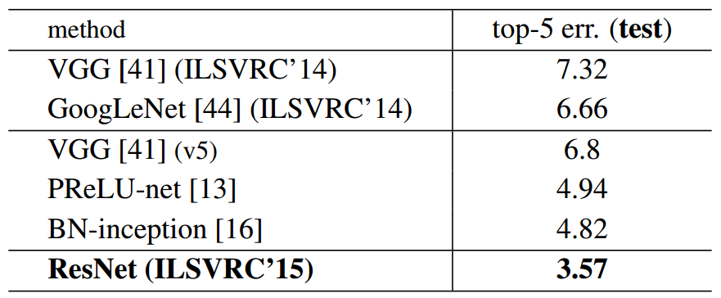
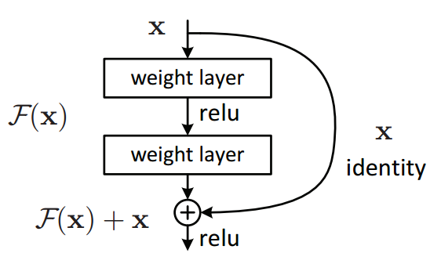
ResNet
Can we just increase the #layer?
How can we train very deep network?
- Residual learning

Slide 17
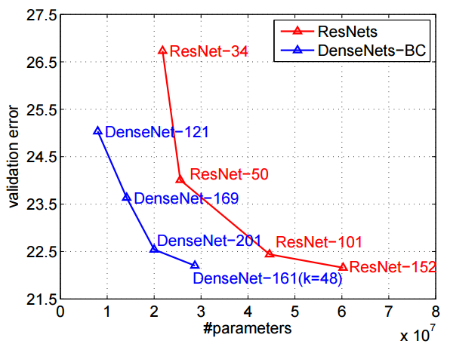
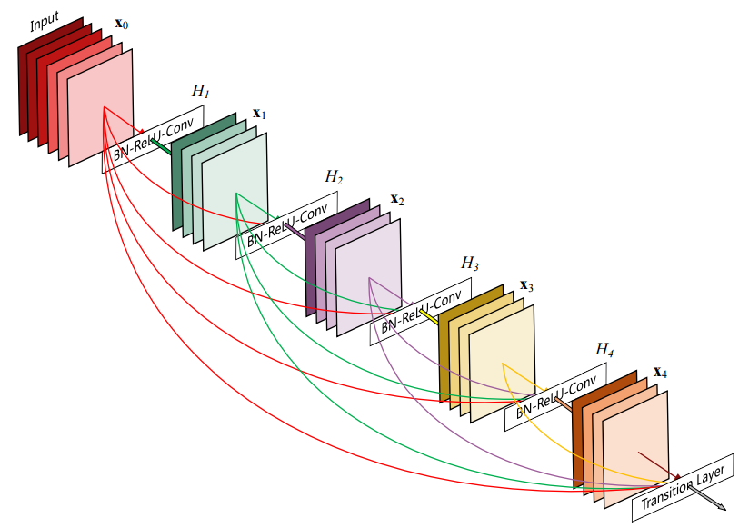
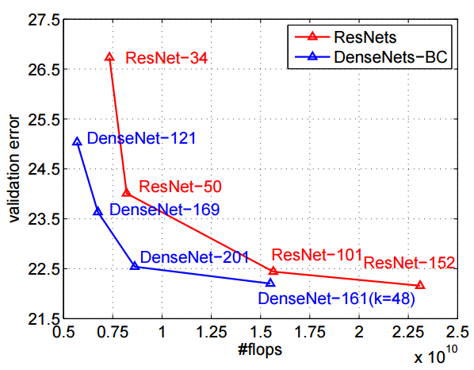
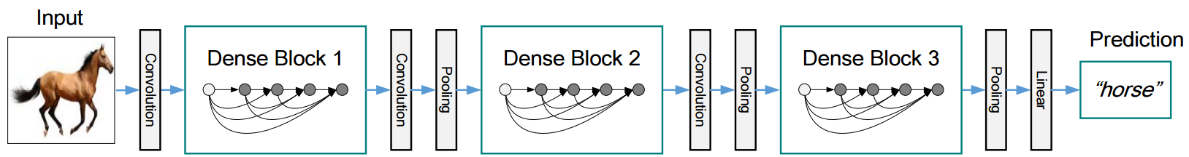
DenseNet
Shorter connections (like ResNet) help
Why not just connect them all?

Slide 18
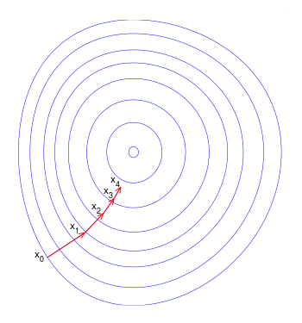
Training CNN with gradient descent
A CNN as composition of functions
$$f_{w}\left(x\right)={f_{L}(… (f}_{2}\left(f_{1}\left(x;w_{1}\right);w_{2}\right)…;w_{L})$$
Parameters
  $$w=(w_{1}, w_{2},…w_{L})$$
Empirical loss function
  $$L\left(w\right)= \frac{1}{n}\sum_{i}{l(z_{i}, f_{w}(x_{i}))}$$
Gradient descent
$$w^{t+1}=w^{t} − η_{t}\frac{∂f}{∂w}(w^{t})$$
New weight
Old weight
Learning rate
Gradient

Slide 19
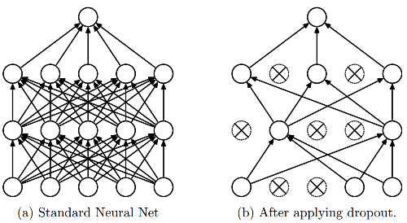
Dropout
Intuition: successful conspiracies
50 people planning a conspiracy
Strategy A: plan a big conspiracy involving 50 people
  Likely to fail. 50 people need to play their parts correctly.
Strategy B: plan 10 conspiracies each involving 5 people
  Likely to succeed!
Dropout: A simple way to prevent neural networks from overfitting [Srivastava JMLR 2014]

Slide 20
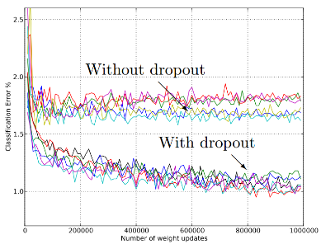
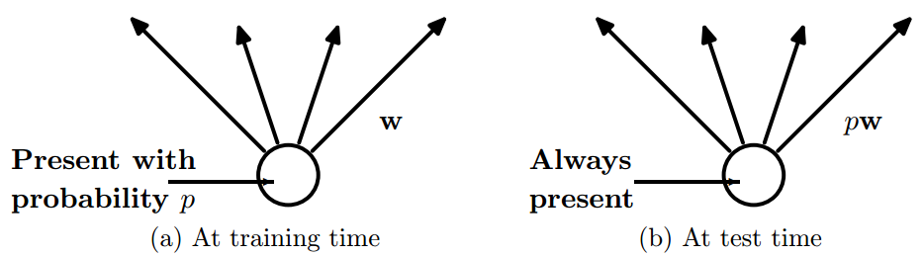
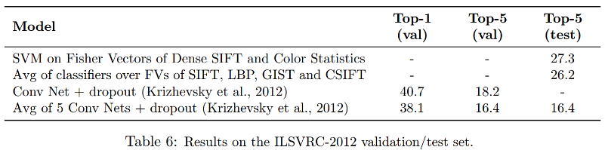
Dropout
Main Idea: approximately combining exponentially many different neural network architectures efficiently
Dropout: A simple way to prevent neural networks from overfitting [Srivastava JMLR 2014]

Slide 21
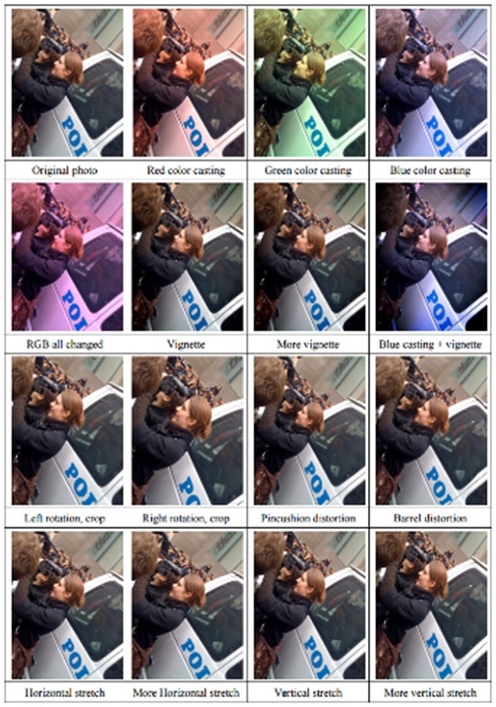
Data Augmentation (Jittering)
Create virtual training samples
  Horizontal flip
  Random crop
  Color casting
  Geometric distortion
Deep Image [Wu et al. 2015]

Slide 22
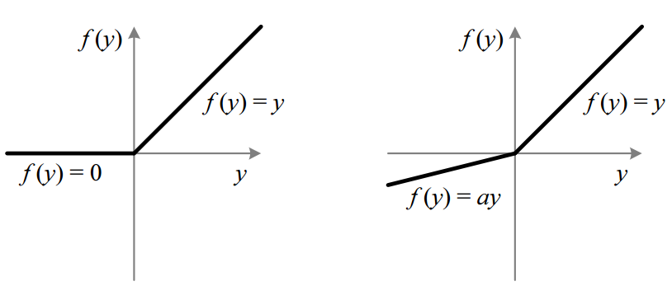
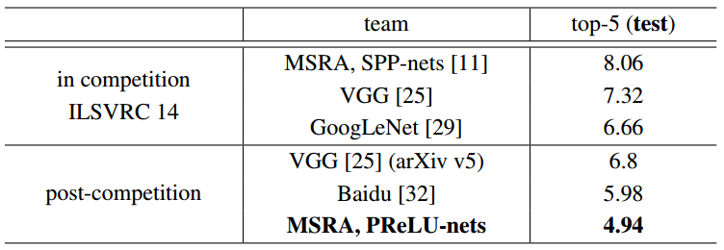
Parametric Rectified Linear Unit
Delving Deep into Rectifiers: Surpassing Human-Level Performance on
ImageNet Classification [He et al. 2015]

Slide 23
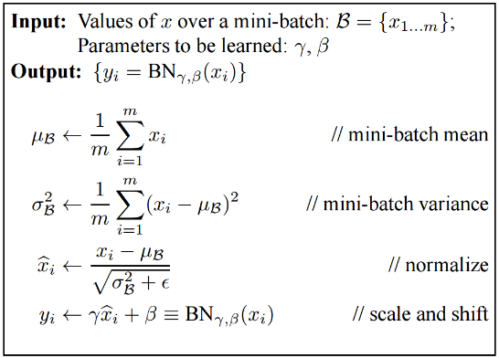
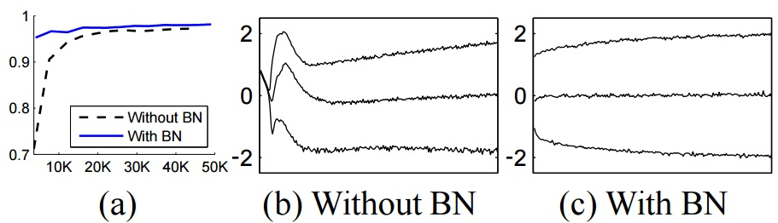
Batch Normalization
Batch Normalization: Accelerating Deep Network Training by
Reducing Internal Covariate Shift [Ioffe and Szegedy 2015]

Slide 24
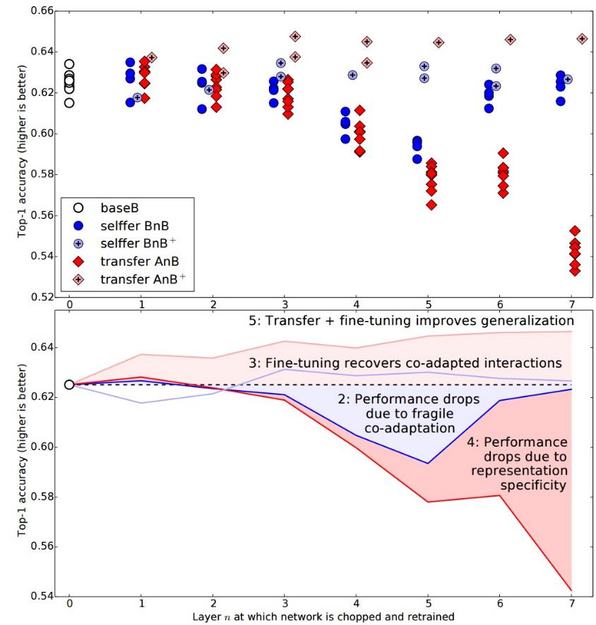
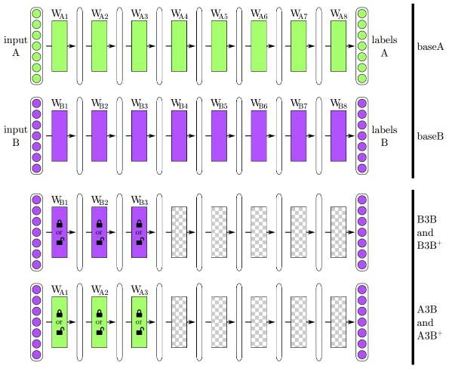
How transferable are features in CNN?
How transferable are features in deep
neural networks [Yosinski NIPS 2014]

Slide 25
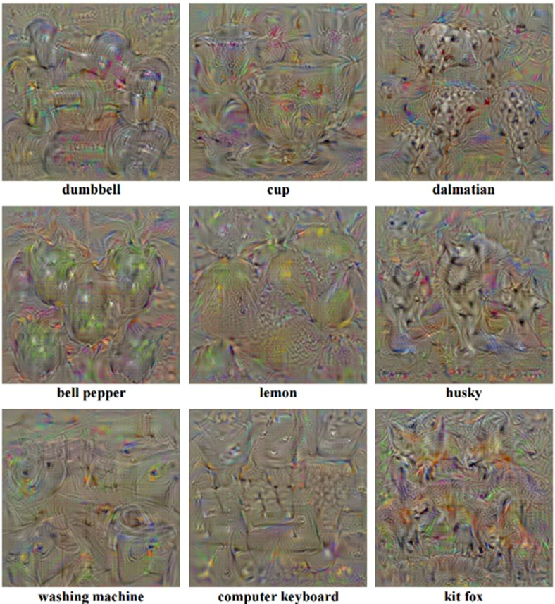
Find images that maximize some class scores
person: HOG template
Deep Inside Convolutional Networks: Visualising Image Classification Models and Saliency Maps
[Simonyan et al. ICLR Workshop 2014]

Slide 26
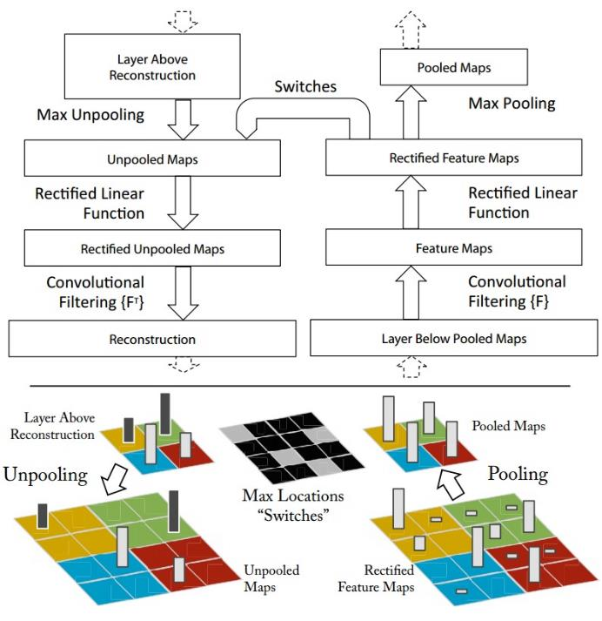
Map activation back to the input pixel space
What input pattern originally caused a given activation in the feature maps?
Visualizing and Understanding Convolutional Networks [Zeiler and Fergus, ECCV 2014]

Slide 27
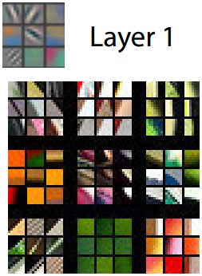
Layer 1
Visualizing and Understanding Convolutional Networks [Zeiler and Fergus, ECCV 2014]

Slide 28
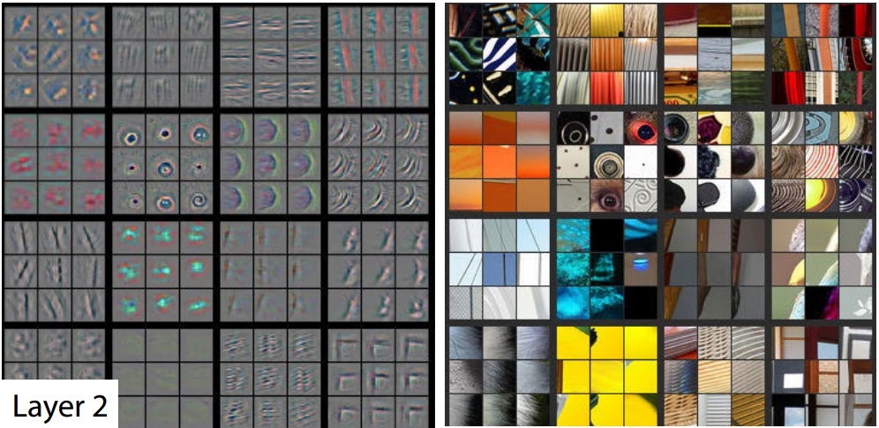
Layer 2
Visualizing and Understanding Convolutional Networks [Zeiler and Fergus, ECCV 2014]

Slide 29
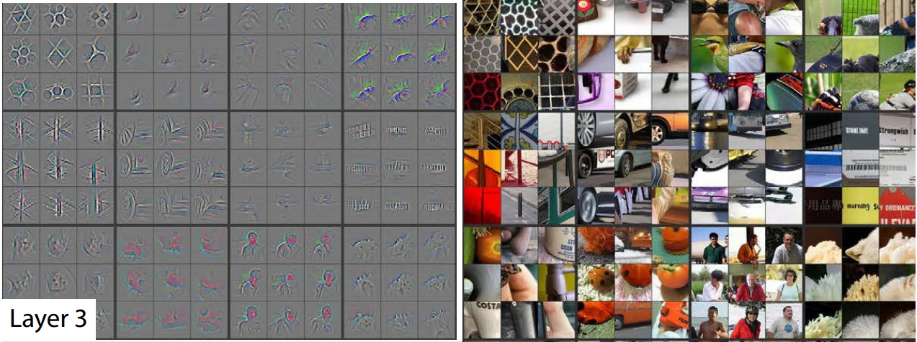
Layer 3
Visualizing and Understanding Convolutional Networks [Zeiler and Fergus, ECCV 2014]

Slide 30
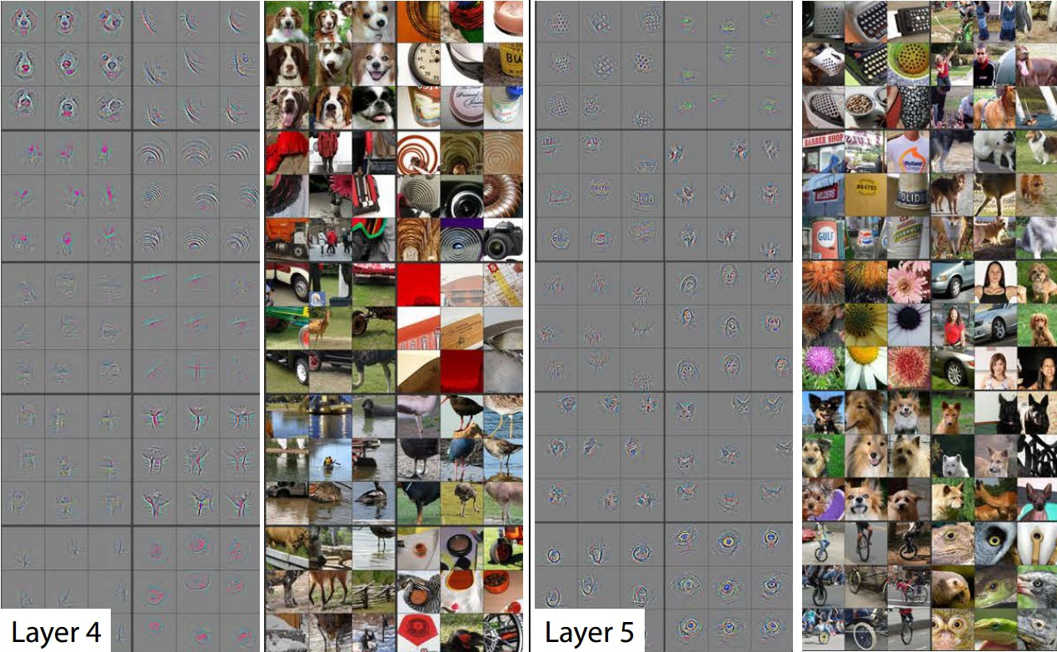
Layer 4 and 5
Visualizing and Understanding Convolutional Networks [Zeiler and Fergus, ECCV 2014]

Slide 31
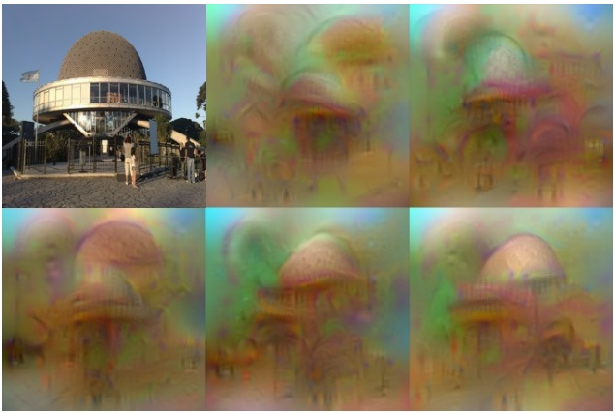
Invert CNN features
Reconstruct an image from CNN features
Understanding deep image representations by inverting them
[Mahendran and Vedaldi CVPR 2015]

Slide 32
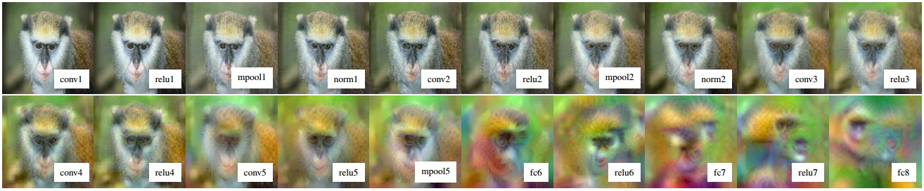
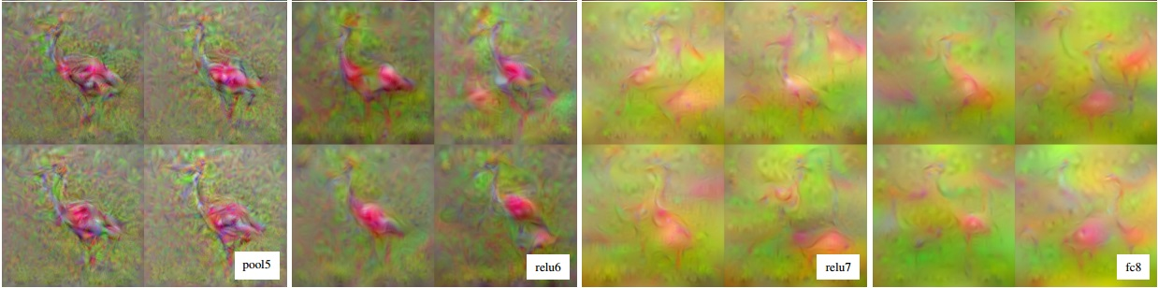
CNN Reconstruction
Reconstruction from different layers
Multiple reconstructions
Understanding deep image representations by inverting them
[Mahendran and Vedaldi CVPR 2015]

Slide 33
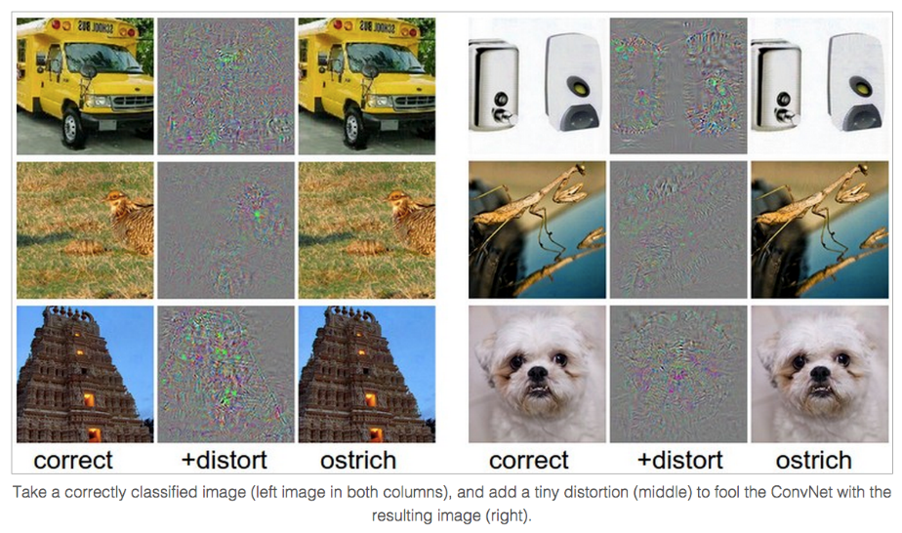
Breaking CNNs
Intriguing properties of neural networks [Szegedy ICLR 2014]

Slide 34
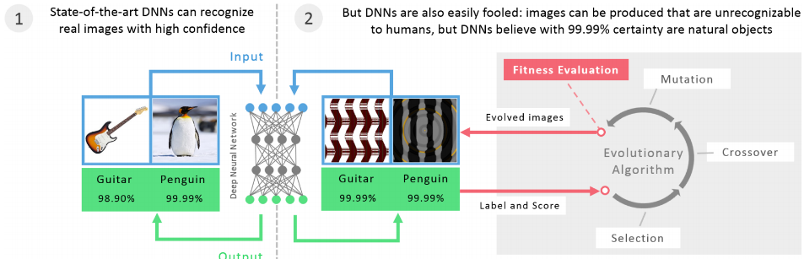
Breaking CNNs
Deep Neural Networks are Easily Fooled: High Confidence Predictions for Unrecognizable Images [Nguyen et al. CVPR 2015]

Slide 35
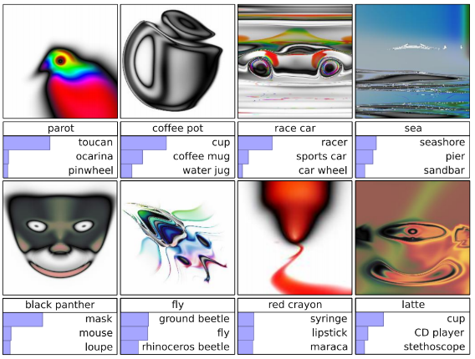
Images that both CNN and Human can recognize
Deep Neural Networks are Easily Fooled: High Confidence Predictions for Unrecognizable Images [Nguyen et al. CVPR 2015]

Slide 36
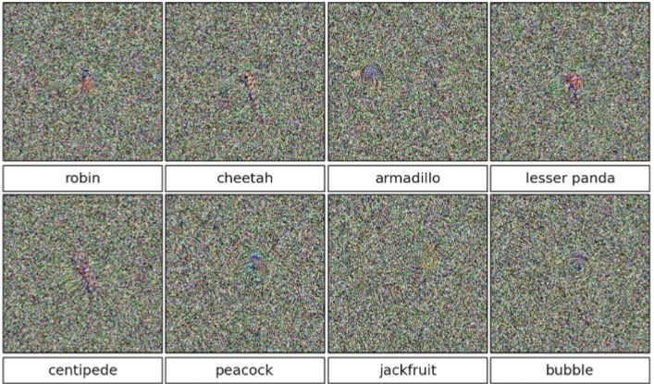
Direct Encoding
Deep Neural Networks are Easily Fooled: High Confidence Predictions for Unrecognizable Images [Nguyen et al. CVPR 2015]

Slide 37
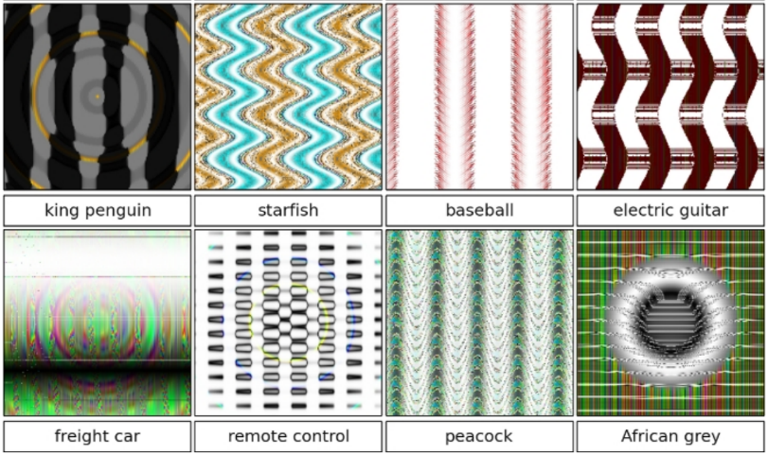
Indirect Encoding
Deep Neural Networks are Easily Fooled: High Confidence Predictions for Unrecognizable Images [Nguyen et al. CVPR 2015]

Slide 38
R-CNN (Girshick et al. CVPR 2014)
Replace sliding windows with “selective search” region proposals (Uijilings et al. IJCV 2013)
Extract rectangles around regions and resize to 227x227
Extract features with fine-tuned CNN (that was initialized with network trained on ImageNet before training)
Classify last layer of network features with SVM
http://arxiv.org/pdf/1311.2524.pdf

Slide 39
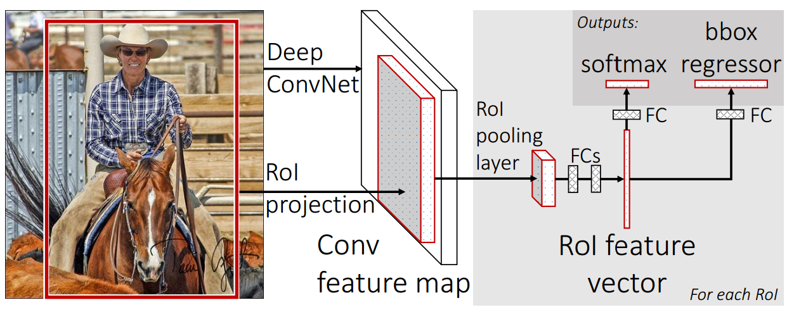
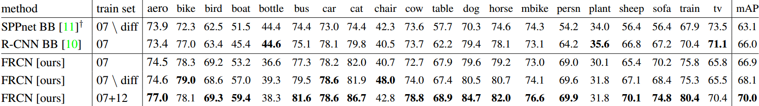
Fast RCNN, ICCV 2015

Slide 40


Faster R-CNN: Towards Real-Time Object Detection with Region Proposal Networks, NIPS 2015

Slide 41

YOLO: Real-Time Object Detection, CVPR 2016

Slide 42


SSD: Single Shot MultiBox Detector, ECCV 2016

Slide 43


YOLO9000: Better, Faster, Stronger, arXiv 2016

Slide 44

Fully Convolutional Networks for Semantic Segmentation, CVPR 2015

Slide 45

Combining what and where
Fully Convolutional Networks for Semantic Segmentation, CVPR 2015

Slide 46

DeepLab: Semantic Image Segmentation with Deep Convolutional Nets, Atrous Convolution, and Fully Connected CRFs, 2016

Slide 47


Atrous convolution

Slide 48

Atrous spatial pyramid pooling

Slide 49

Dilated convolution
Multi-scale Context Aggregation by Dilated Convolutions, ICLR 2016

Slide 50


Pyramid Scene Parsing Network, 2016

Slide 51

Pyramid Scene Parsing Network, 2016

Slide 52


Siamese/Triplet networks for distance metric learning
Distance metric learning
  Learn feature embedding so that the distances capture the semantic similarity
D( ‘Tech’, ‘Taco’) = 3
D( , ) = 25
D( , ) = 50
D( , ) = ?

Slide 53


Siamese Network
Learning Deep Representations for Ground-to-Aerial Geolocalization, CVPR 2015

Slide 54


Learning Deep Representations for Ground-to-Aerial Geolocalization, CVPR 2015

Slide 55




Negative examples
Positive examples
Computing the Stereo Matching Cost with a Convolutional Neural Network, CVPR 2015

Slide 56

Computing the Stereo Matching Cost with a Convolutional Neural Network, CVPR 2015

Slide 57



Triplet loss
FaceNet: A Unified Embedding for Face Recognition and Clustering, CVPR 2015

Slide 58

Problem: Multi-face tracking
Tracking Persons-of-Interest via Adaptive Discriminative Features, ECCV 2016

Slide 59




Major challenge: large appearance variations
Sojin
Minah
Yura
Hyeri
Need discriminative features

Slide 60

Discover constraints from videos
Same person
Different persons

Slide 61

Qualitative results

Slide 62





Slide 63


Quantitative Results
T-ara
Bruno Mars

Slide 64
Things to remember
Learning distance is crucial for
  Matching
  Retrieval
  Recognition
  Re-identification
Two common strategies
  Siamese network
  Triplet network

